Slide 1
Data Pipeline

Slide 2
Data pipeline
Stages of Data pipeline
Ingestion
Ingest from Directory (List of files) or file
File Formats supported
CSV
Json
(basically all pandas read function can be exposed as Rest Api)
Transformations
Fillna (given value,mean,zero etc)
LowerCase
Trimming (symbol trimming)
Formating
Data Availability
Query the data for given SQL

Slide 3






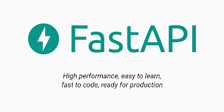



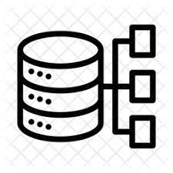

Architecture
Ingestion
Transformations
Data Query
Local folders
Big data or cloud Files
Backend Database : SQL /NoSQL
-PostgreSQL /MongoDB

Slide 4


Async Multiprocessing pipeline Architecture
Ingestion
Transformations
Data Query
Local folders
Big data or cloud Files
Task Queue
Backend Database : SQL /NoSQL
-PostgreSQL /MongoDB

